Slide 1

SVKM’s Institute of Technology, Dhule Department of Information Technology
Mini Project Presentation
On
“Detection Human Faces From A Video”
By
14004200006, Vaishali Bhadane 14004200028, Snehal Nikam 14004200061, Ramandeepkaur Banvat 14004210064, Siddheshwari Badgujar
Guide
Dr. Bhushan Chaudhari

Slide 2
Contents
Mini Project Group
Motivation
Introduction
Literature Survey
System Flowchart
Sequence Diagram
Applications
Conclusions
References

Slide 3
Project Details
Mini Project Title : Detecting Human Faces From A Video
Mini Project Domain : AI and ML
Mini Project Group Members :
14004200006, Vaishali Bhadane 14004200028, Snehal Nikam 14004200061, Ramandeepkaur Banvat 14004210064, Siddheshwari Badgujar

Slide 4
Motivation
Face detection technology provides better security and surveillance opportunities. It increases the level of protection . Facial detection software will be the foundation for the identification of criminals.

Slide 5
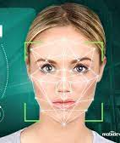
Problem statement
Develop the system which detect and the human faces from video using Artificial Intelligence and Machine Learning.

Slide 6
Aim and Objectives of the Project
Aim:
To make the human face detection system .
Objectives:
Search facial features
Face tracking
Multiple face recognition

Slide 7
Introduction
Face detection from video is a process of identifying faces in a video.
It is a powerful tool that can help detect and track people in a video.

Slide 8

Introduction
This technology is becoming increasingly important in a variety of applications.
It can be used to avoid the threads to security.

Slide 9
Literature Survey/Related work
Minimum FIVE references should be there from literature.
Sr. No. | Citation number | Seed Idea/ Work description | Parameters Used | Issues identified
1 | [2] | A normal surveillance scene have poor conditions and it is very difficult to detect the people involve. In this context, it propose the use of super resolution algorithms to improve the results of a face detector algorithm in order to recognize people in a violent scene | Violent scene detector, a normalization algorithm and a face detector | For some very low resolution videos, the SR does not meet expectations, because having too little of pixels per frame, interpolation is difficult without being able to generate higher resolution video

Slide 10
Literature Survey/Related work
2 | [1]​ | In their paper "Deep learning-driven automated person detection and tracking model on surveillance videos", S. Sivachandiran and team present a new DL-driven automated person detection and tracking model on surveillance videos. The video is converted into a set of frames, and the model is developed to detect people as objects and track them​ | Data driven Automated Person Detection and Tracking(-APDT)​ EfficientDet model​ | Detecting and tracking peformance of DLD-APDT​

Slide 11
Literature Survey/Related work
3​​ | [4]​​ | Face recognition for attendace management​​ | Face recognition using Dual Cross Pattern (DCP) . | ​​-
4​​ | [3]​​ | ​​Face recognition tracks target objects in live video images taken with a video camera | ​​KLT algorithm , PCA algorithm | ​​Poor Lighting Conditions

Slide 12
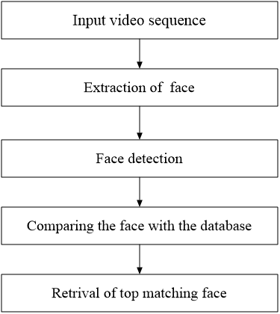
Flowchart
input

Slide 13
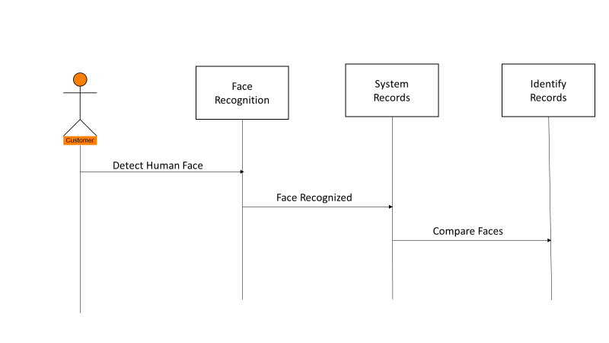
Sequence Diagram

Slide 14
ALGORITHM & LIBRARY
Algorithm:
Haar Cascade Classifiers: Popular technique using machine learning and image features to detect faces efficiently.
Libraries used:
Numpy
Open cv
Pillow
Face

Slide 15
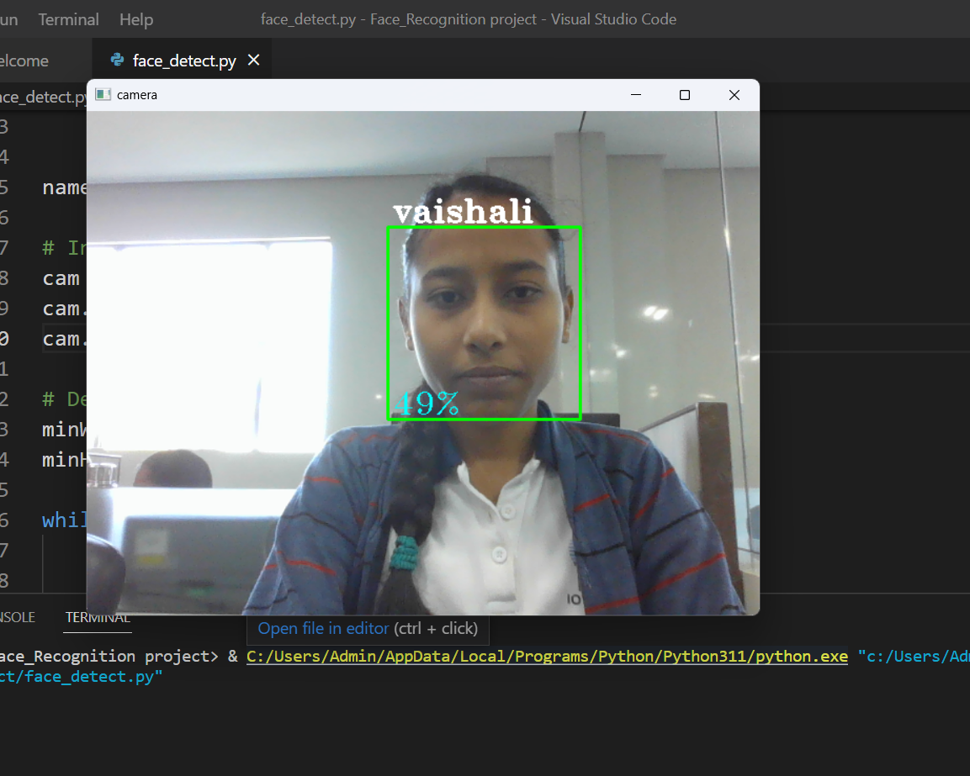
RESULTS
ACCURACY: 49 %
FACE DETECTED: VAISHALI

Slide 16

Applications
To detect intruders in a premise.
To recognize people in crowd and detect suspicious activity.
To identify employee or visitors of an organization
To improve security.
Project Title Goes here

Slide 17
Conclusions
Face detection from video is a complex task that requires the use of various techniques.
Despite the challenges, face detection from video has numerous potential applications.
It can be used for security and surveillance, entertainment, and facial recognition.
This presentation also discussed the challenges associated with face detection and the potential applications of the technology.

Slide 18
References
[1] Sivachandiran a, K. Jagan Mohan b, G. Mohammed Nazer c ,Deep Learning driven automated person detection and tracking model onsurveillance (2022)
[2] V.E. Machaca Arceda, K.M. Fernández Fabián, J.J. Rivera Tito, Fast Face Detection in Violent Video ScenesFast(2022)
[3] Shivam Singh ,Prof. S. Graceline Jasmine ,Face Recognition System,Vol. 8 Issue 05, May-2019
[4]Yogameena B., Geeta Jakkamsetti, Aishwarya S. ,SpyGAN sketch: Heterogeneous Face Matching in video for crime investigation(2022)
[5]Rana Qarooni a, Jonathan Prunty b, Markus Bindemann b, Rob Jenkins a,Capacity limits in face detection(2022
[6]Serign Modou Bah, Fang Ming, An improved face recognition algorithm and its application in attendance management system(2020)

Slide 19
References
[7]M. Castrillón, O. Déniz ENCARA2: Real-time detection of multiple faces at different resolutions in video streams(2022)

Slide 20


